Slide 1
Bio Beat
SYSC 3010
Final Presentation
December 4, 2013

Slide 2
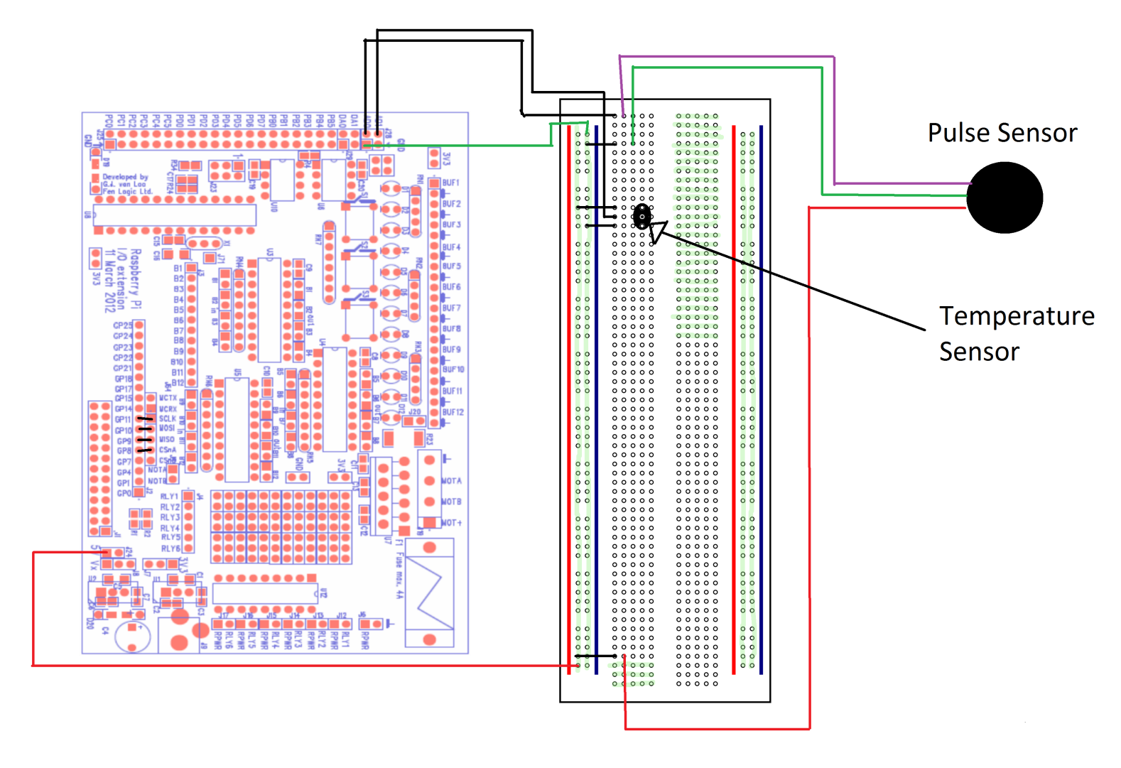
Pulse and Temperature Sensor Circuit

Slide 3
UserData Class
heart : GpioController
clk : GpioPinDigitalOutput
CS : GpioPinDigitalOutput
dataOut : GpioPinDigitalOutput
dataIn : GpioPinDigitalInput
+ getBeat() : Integer
+ getTemp(previousTemp : double) : Double
+ shutDown()
- getAnalogData(channel : int) : Integer

Slide 4
Monitor Class
send : DataTransmission
data : UserData
temp : Double
beat : Integer
- init()
- newTemp(previousTemp : double) : Double
- newBeat() : Integer
- sendMood(mood : Integer)
- findMood(temp : double, beat : int) : Integer
- shutDown()

Slide 5
Class Diagram
UserData
Monitor

Slide 6
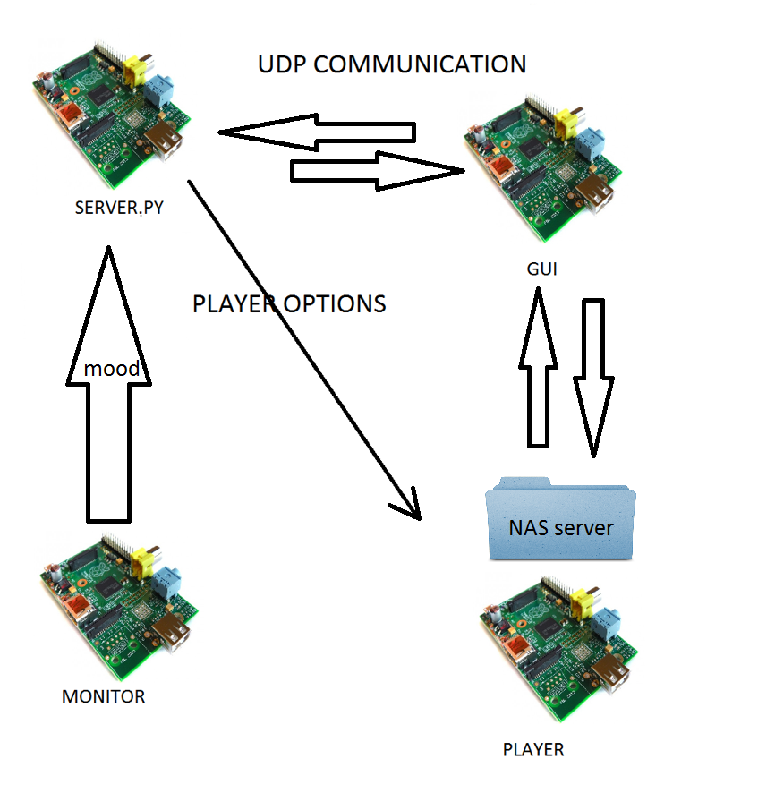
Overall Architecture

Slide 7
PlayerPi User Options
Play a song
Stop the song
Pause the song
Unpause the song
Increase volume
Decrease volume

Slide 8
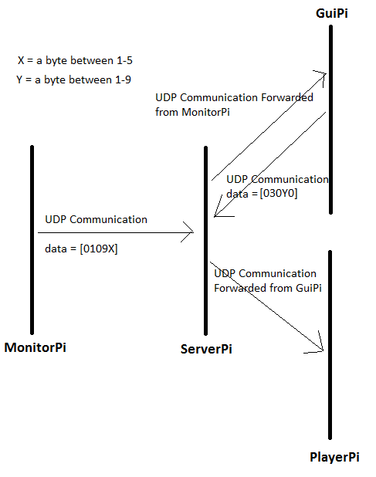
Timing Diagram

Slide 9
GuiPi UML Class diagrams
CentralMain
+loadXML(xml_path:String)
+getMoodsList()
+getPlayList()
+displayErrorDialog(msg:String)
Moods.XML
Songs.XML
GUIController
SongListTreeModel
PlayList
+addSong(path:String,mood:String)
+deleteSong(name:String,mood:String)
+getSongsByMood(mood:String)
GUI

